Slide 1
UNIVERSITY OF HARGEISA
Faculty of ICT and Distance Learning
Introduction of HTML

Slide 2
Introduction of HTML
What is HTML?
HTML, which stands for HyperText Markup Language, is a markup language used to create web pages.
HTML documents are described by HTML tags
Each HTML tag describes different document content
There are Two types of tags in HTML:
Paired tags (Opening and Closing tags. Ex. <h1>Some text</h1>
Unpaired tags/Empty tags. Ex. <br>,<hr>
HTML tags are not case sensitive
Faculty of ICT and Distance Learning

Slide 3
Introduction of HTML…
What do I need to create HTML?
You don't need any special equipment or software to create HTML. You already have. Here is what you need:
Computer: computers already have a text editor and you can easily create HTML files using a text editor.
Web Browser. For example, Internet Explorer, Google Chrome or Firefox.
Do I need to be online?
No, you do not need to be online to create web pages.
You can create web pages on your local machine.

Slide 4
Getting Started:
How to start :
Write HTML code in notepad.
Save the file with (.html or .htm) extension.
View the page in any browser.
Creating a Webpage:
Create an HTML file: simply a text file saved with an .html or .htm extension.
Type some HTML code
<html>
<head>
<title>My first Web Page</title> </head>
<body>
Less than 5 minutes into this HTML tutorial and I've already created my first homepage!</body>
</html>

Slide 5
Explanation of code
lets look more closely at the example that we created in the previous lesson.
<html> element can be thought of as a container that all other tags sit inside (except for the !DOCTYPE tag).
The <head> tag contains information that is not normally viewable within your browser (such as meta tags, JavaScript and CSS), although the <title> tag is an exception to this.
<title> The <title> tag is used inside the <head> tag to mention the document title.
The <body> tag is where most of your code will go.
Closing your tags:
The closing tag contains a forward slash (/) after the <. This tells the browser that this tag closes the previous one.
UPPERCASE or lowercase?
Although most browsers will display your page regardless of the case you use, you should always code in lowercase.

Slide 6
Text Formatting tags
Heading element:
There are six heading elements:
(<h1>,<h2>,<h3>,<h4>,<h5>,<h6>)
All six heading elements are container tags (Paired tags) and requires closing tag.
<h1> will print the largest heading.
<h6> with print the smallest heading.
Example:

Slide 7
Text Formatting tags…
Bold
You specify bold text with the <b> tag.
Typing this code:
<b>This text is bold.</b>
Results in this:
This text is bold.
Italics
You specify italic text with the <i> tag.
Typing this code:
<i>This text is italicized.</i>
Results in this:
This text is italicized.

Slide 8
Text Formatting tags…
Line Breaks:
Typing this code:
<p>Here is a...<br />line break.</p>
Results in this:
Here is a line break.
Horizontal Rule:
Typing this code:
Here's a horizontal rule... <hr /> ...that was a horizontal rule :)
Results in this:
Here's a horizontal rule...

Slide 9
Text Formatting tags…
Unordered (un-numbered) List
Type this code in your text editor and see the result:
<ul>
<li>List item 1</li>
<li>List item 2</li>
</ul>
Ordered (numbered) List:
<ol>
<li>List item 1</li>
<li>List item 2</li>
</ol>
Note, that the only difference between an ordered list and an unordered list is the first letter of the list definition ("o" for ordered, "u" for unordered).

Slide 10
Text Formatting tags…
Unordered List:
TYPE attribute to the <UL> tag to show different bullets like:-
Disc
Circle
Square
<ul type =“disc”>…..</ul>
Ordered List:
The TYPE attribute has the following value like:-
TYPE = "1" (Default-Case Numerals.)
TYPE = "a" (Lowercase alphanumeric)
TYPE = "A" (Uppercase alphanumeric)
TYPE = "i" (Lowercase Roman numbers)
TYPE = "I" (Uppercase Roman numbers)

Slide 11
HTML Definition Lists
Entries are listed like in a dictionary or encyclopedia.
The definition list is the ideal way to present a glossary, list of terms, or other name/value list.
Definition List makes use of following three tags.
<dl> - Defines the start of the list
<dt> - A term
<dd> - Term definition
</dl> - Defines the end of the list

Slide 12
Font Tag:
This element is used to format the size, typeface and color of the enclosed text.
The commonly used fonts for web pages are Arial, Comic Sans MS , Lucida Sans Unicode, Arial Black, Courier New, Times New Roman, Arial Narrow, Impact, Verdana.
The size attribute in font tag takes values from 1 to 7.

Slide 13
HTML Attributes
Attributes provide additional information about HTML element
HTML elements can have attributes
Attributes provide additional information about an element
Attributes are always specified in the start tag
Attributes come in name/value pairs like: name="value“
E.g: The attribute bgcolor is used for changing the background color of the page.
<body bgcolor=“Green” >
Text is use to change the color of the enclosed text.
<body text=“White”>

Slide 14
Align Attribute
The align attribute specifies the alignment of the text within a paragraph.
Syntax:
<p align="left | right | center | justify">
Example:
A right-aligned paragraph:
<p align="right">This is some text in a paragraph.</p>

Slide 15
HTML Styles
HTML Styling
Every HTML element has a default style (background color is white and text color is black).
Changing the default style of an HTML element, can be done with the style attribute.
This example changes the default background color from white to lightgrey:
Example:-
<body style="background-color:lightgrey"> <h1>This is a heading</h1> <p>This is a paragraph.</p> </body>

Slide 16
The HTML style attribute has the following syntax:
style="property:value“
HTML style attribute has many properties include:
The color property defines the text color to be used for an HTML element:
The font-family property defines the font to be used for an HTML element:
The font-size property defines the text size to be used for an HTML element:
The text-align property defines the horizontal text alignment for an HTML element:

Slide 17
HTML Colors
Color Names:
The most common methods for specifying colors are by using the color name or the hexadecimal value.
To add color to an HTML element, you use style="color:{color}", where {color} is the color value.
For example:
<h3 style="color:blue">HTML Colors</h3>
This results in:
HTML Colors

Slide 18
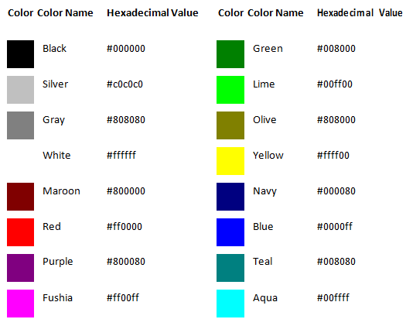
HTML Colors…
Color Names:

Slide 19
HTML Comments
Comment tags <!-- and --> are used to insert comments in HTML.
You can add comments to your HTML source by using the following syntax:
<!-- Write your comments here -->

Slide 20
Thank You !
Faculty of ICT and Distance Learning

